Slide 1


Student details
Name : HIMAKAR REDDY KETHU | AP22110011215
Email : himakarreddy_kethu@srmap.edu.in
College Name : SRM University AP
College State : Andhra Pradesh
Domain / Date : Data Analytics / 03-06-2024 to 25-07-2024

Slide 2
Comprehensive Analysis of Car Dekho Dataset: Trends, Insights and Anomalies.

Slide 3
AGENDA
Project Overview.
Who are the end users of this project?
Solution and its value Proposition.
How did you customize the project and make it your own ?
Modelling.
Results.
Links and References.

Slide 4
PROJECT OVERVIEW
Purpose :
The project aims to analyze vehicle depreciation trends using the Car Dekho dataset, employing data analytics to optimize pricing strategies and enhance market insights in the automotive industry.
Scope :
Analyzing the Car Dekho dataset to extract insights into vehicle depreciation trends based on factors such as age, mileage, and brand.
Developing predictive models to forecast vehicle depreciation rates and optimize pricing strategies for stakeholders in the automotive industry.
Provide actionable insights to stakeholders in the automotive industry for better decision-making.

Slide 5
PROJECT OVERVIEW
Objectives :
Identify key factors influencing vehicle depreciation based on historical sales data.
Develop predictive models to forecast depreciation rates and optimize pricing strategies.
Provide actionable insights to stakeholders in the automotive industry for better decision-making.
Enhance understanding of market dynamics and consumer preferences related to vehicle resale values.

Slide 6
WHO ARE THE END USERS of this project?
The end users of the "Data Analysis of the Car Dekho Dataset" project include a diverse group of stakeholders who can benefit from the insights and recommendations derived from the data analysis. These end users are:
1. Car and Bike Dealers
Characteristics: Involved in buying, selling, and manufacturing vehicles.
Needs: Require insights into vehicle depreciation to optimize pricing and manage inventory.
Benefits: Predictive models will help set competitive prices, adjust inventory levels, and improve profitability.

Slide 7
WHO ARE THE END USERS of this project?
2. Resale Platforms
Characteristics: Individuals and businesses interested in buying or selling used vehicles.
Needs: Seek transparency in pricing and reliable predictions of resale values.
Benefits: Insights will empower better decision-making, negotiation, and improved financial outcomes.
3. Market Analysts
Characteristics: Professionals analyzing trends and conducting research in the automotive sector.
Needs: Require comprehensive data and analytical tools to generate insights
Benefits: Project insights will aid in understanding market dynamics, identifying trends, and publishing industry reports.

Slide 8
YOUR SOLUTION AND ITS VALUE PROPOSITION
Manufacturing Years: We found that the Dataset contains vehicles info from 2003 to 2018.
Price Range: The lowest and Highest prices are 10k and 35lakhs. There are 98 different models in both Cars and Bikes.
Most Selled Vehicle: A car named CITY was most sold vehicle in cars and Royal Enfield Classic 350 is most sold Bike in the data.
Depreciation Analysis: The most and least cost depreciated vehicle in data are LAND CRUISER with 57.6lakhs and HONDA ACTIVA 4G with 3k.

Slide 9
YOUR SOLUTION AND ITS VALUE PROPOSITION
Seller Analysis: The selling price is affected by age of vehicle and distance driven by vehicle. We found that by Plotting a scatter plot graph.
General Expectations: There are Two Bikes that exceeded general expectations in selling Price and several cars also exceeded general expectations. Found it by Plotting a boxplot graph.
Four-Wheelers: The Newest Car is Vitara Brezza and Oldest car in the dataset is SX4.
Two-Wheelers: The Oldest Bike in the dataset is Hero Super Splendor and there are several Newest bikes.
Mileage Impact: A strong correlation between mileage and selling price/depreciation is observed, with higher mileage generally correlating with lower selling prices

Slide 10
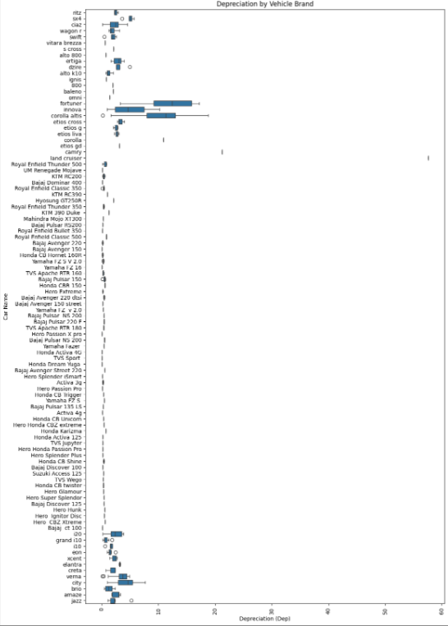
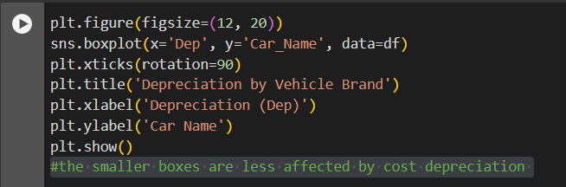
How did you customize the project and make it your own
By finding more insights from the data, it makes my own. Like:
Which brands of vehicles are less affected by cost depreciation ?
I did it with Plotting a scatter plot for Car Name and Depreciation cost. The smaller boxes are less affected by cost depreciation

Slide 11
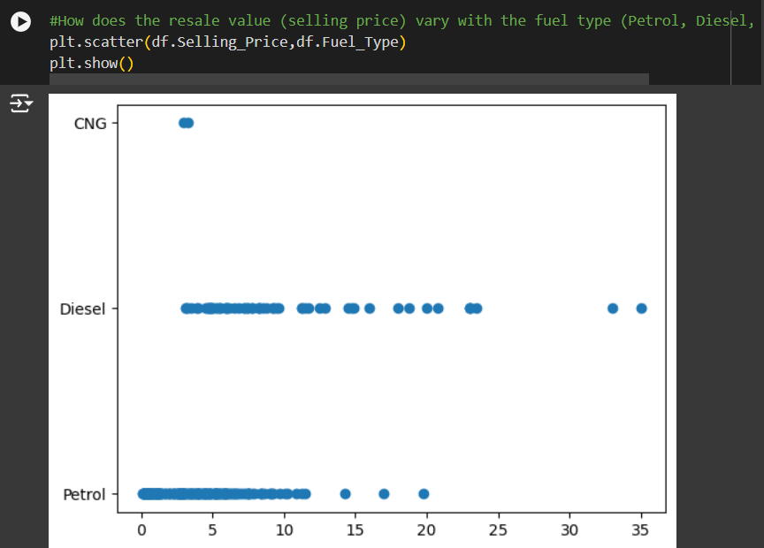
How did you customize the project and make it your own
How does the resale value (selling price) vary with the fuel type (Petrol, Diesel, CNG, Electric)?
It seems like Diesel fuel type vehicles have more Selling price then Petrol and CNG.

Slide 12
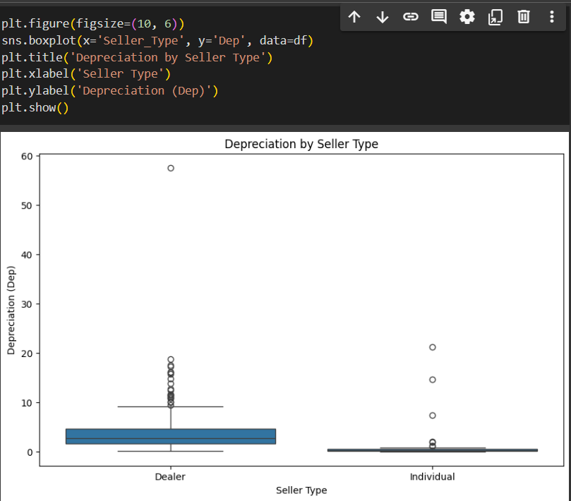
How did you customize the project and make it your own
Is there a significant difference in depreciation between vehicles sold by dealers versus individuals?
By looking the output, it can be said that there is a certain Depreciation for Dealers than Individuals. There is no Depreciation in case of individual.

Slide 13
MODELLING
Firstly, we used Google Colab, a cloud platform, and has uploaded data provided by the instructor into Colab for analysis.
Next, Understanding and Preprocessing the data by using built-in functions in Pandas like head, tail, value_count, info, describe and searched for duplicates.
Then, Cleaned the data. Formed another two tables from the data. One for four wheelers and other for two wheelers.
Finally, We did some analysis using questions provided by the instructor and Concluded some insights by using some functions and graphs.

Slide 14
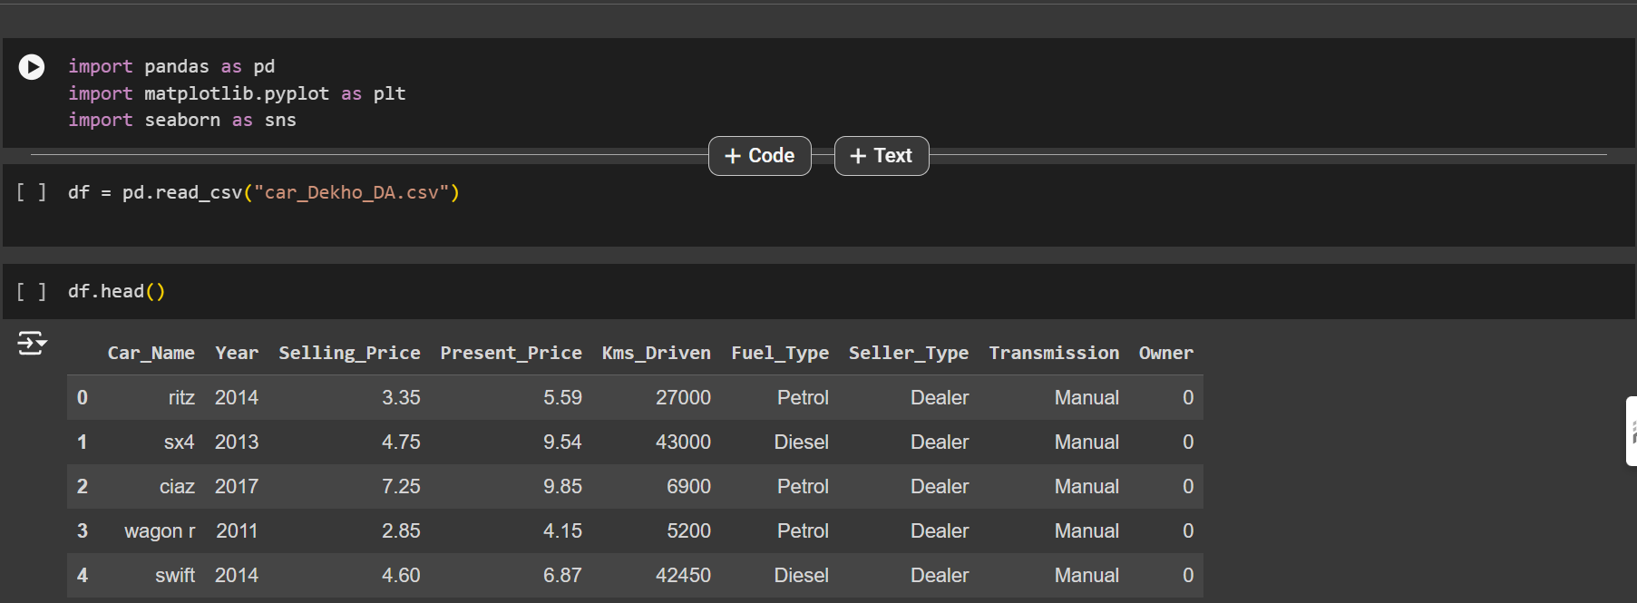
RESULTS
Importing the libraries and Reading the File

Slide 15
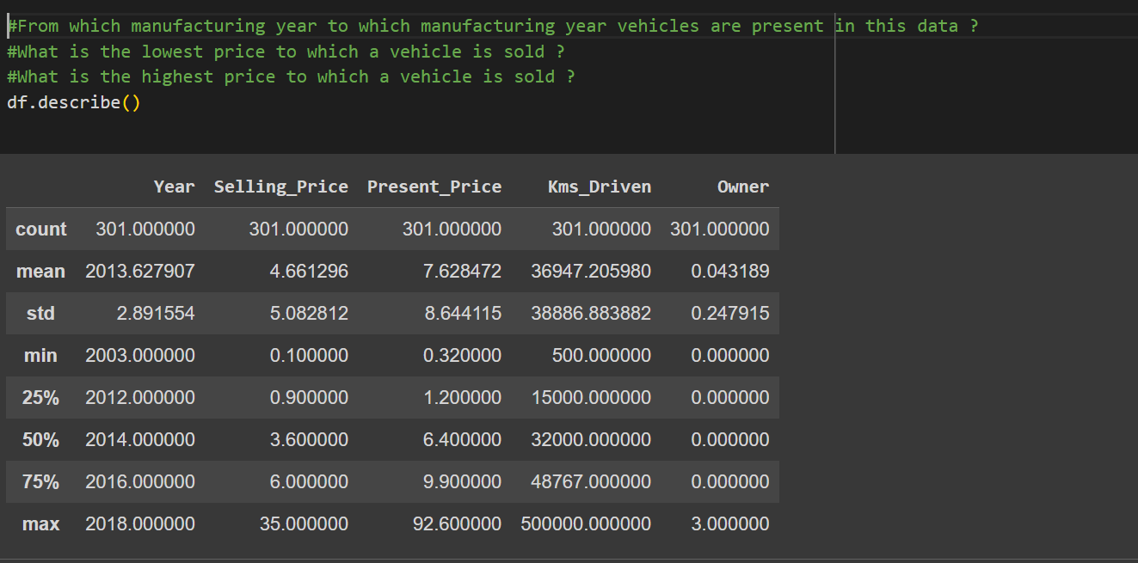
Results
Statistics of the Data

Slide 16
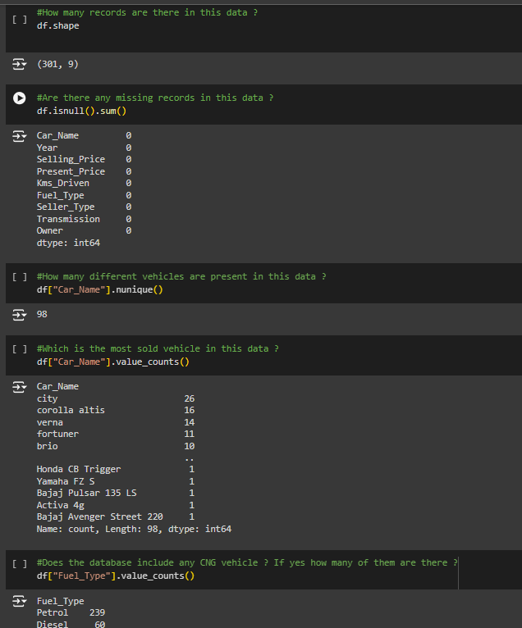
RESULTS
Here we are finding, how many records are there in this data set.
Are there any missing values in the records ?
How many different vehicles are present in the dataset ?
Which is the most sold vehicle in this data ?

Slide 17
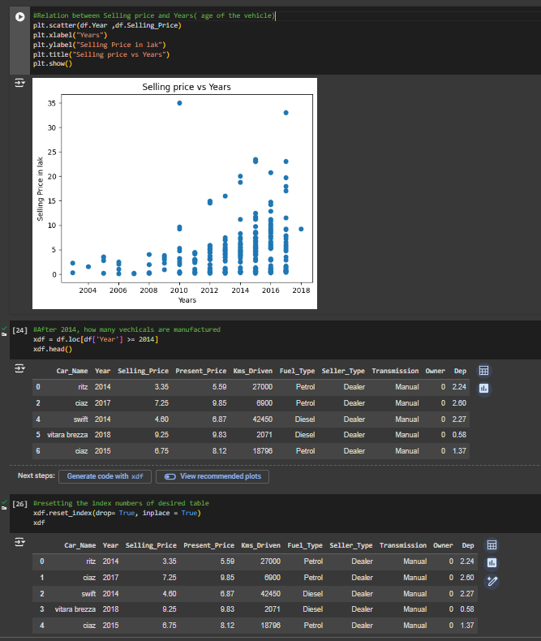
RESULTS
Here we are finding, Relation between Selling price and Years( age of the vehicle).
Create a table for vehicles that are manufactured after year 2014.
And reset the index of the table

Slide 18
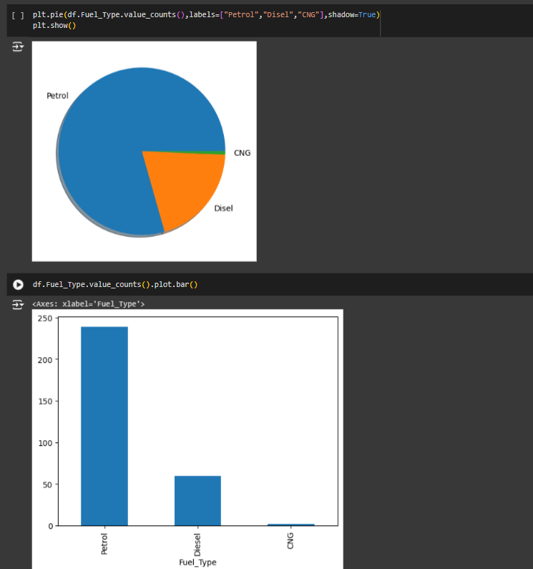
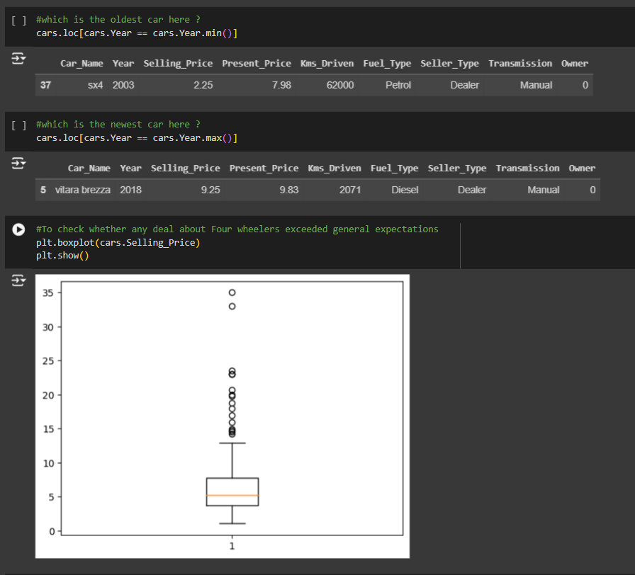
CHECKING THE GENERAL EXPECTATION

Slide 19
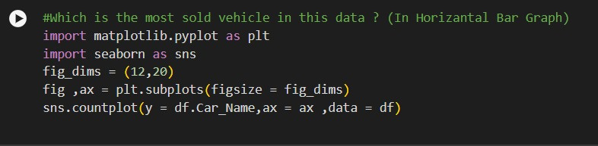
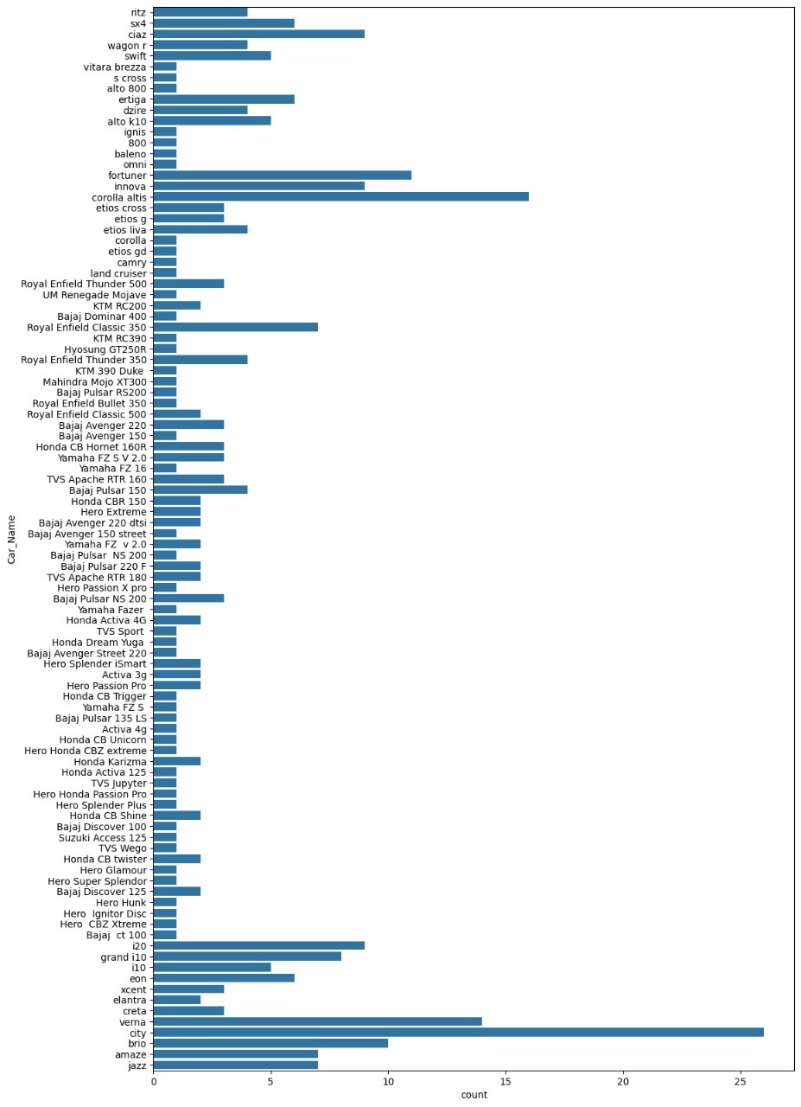
SALES ANALYSIS BY VEHICLE MODEL

Slide 20
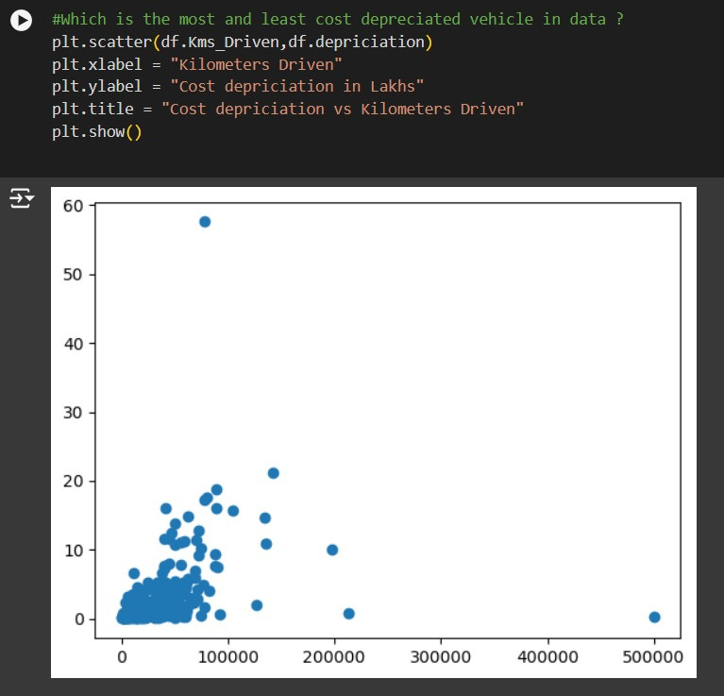
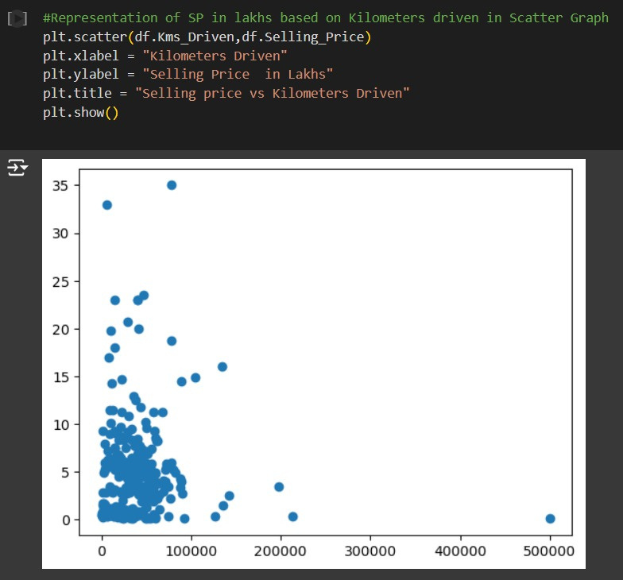
COST DEPRECIATION VS. KILOMETERS DRIVEN
SELLING PRICE VS. KILOMETERS DRIVEN

Slide 21
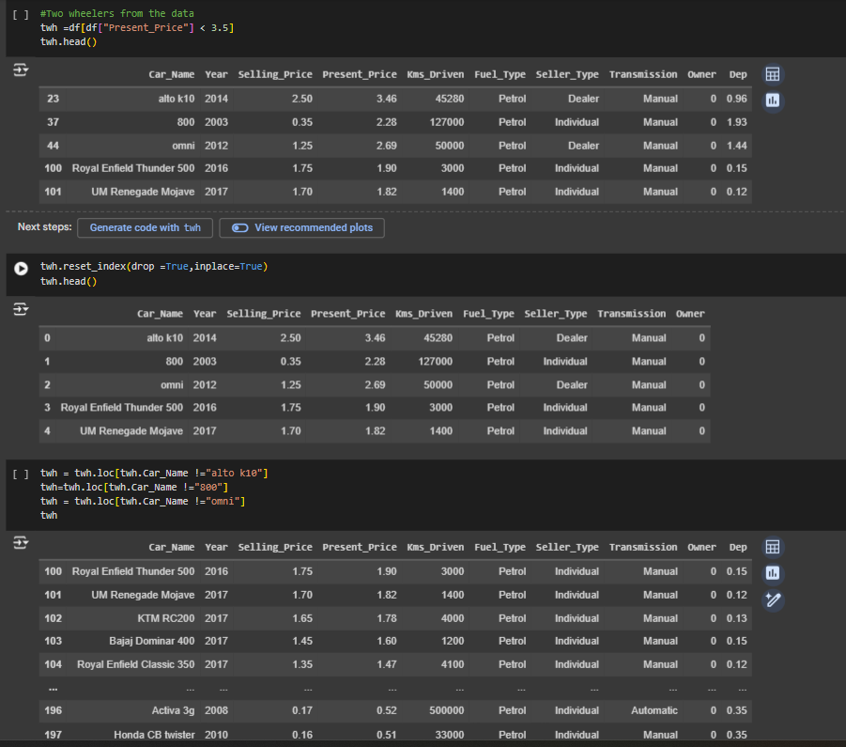
RESULTS
Here we are creating another table for Two wheelers.
By taking the vehicle's present price less than or equal to 3.5 lakhs

Slide 22
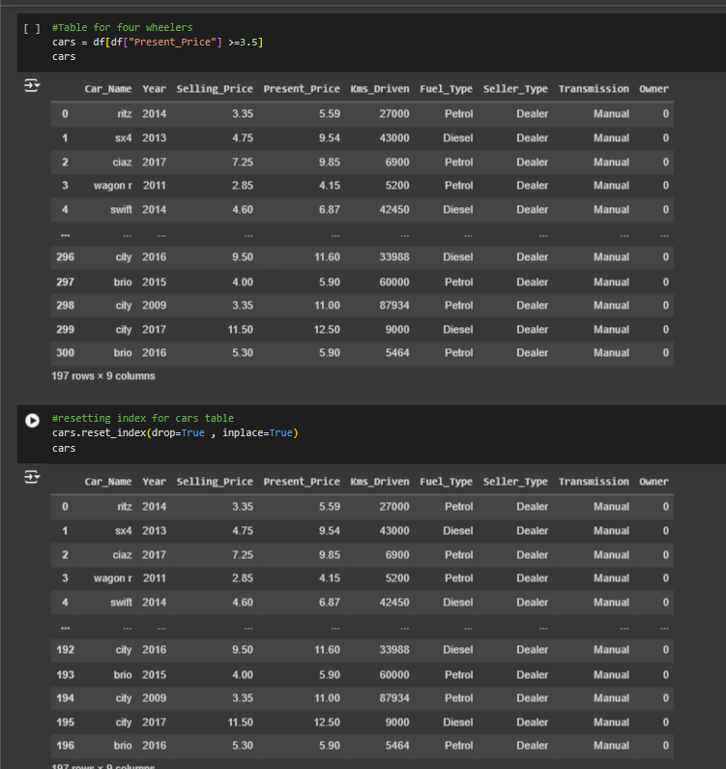
RESULTS
Here we are creating another table for four wheelers.
By taking the vechicle’s present price more than 3.5 lakhs

Slide 23
links
https://github.com/himakar4/Car_Dekho_Data_Analytics_Project
REFERENCES
https://chatgpt.com/
https://www.kaggle.com/
https://skills.yourlearning.ibm.com/activity/PLAN-D0B733510535
https://www.geeksforgeeks.org/data-analysis-tutorial/
https://www.w3schools.com/training/aws/data-analytics-fundamentals.php

